Slide 1
Graph II

Slide 2
Some basic terminologies

Slide 3
Some Basic Terminologies
Def1 : Two vertices u and v in an undirected graph G are called adjacent (or neighbors) in G if u and v are endpoints of an edge e of G. Such an edge e is called incident with the vertices u and v and e is said to connect u and v.

Slide 4
Some Basic Terminologies
Def2 : The set of all neighbors of a vertex v of G = (V, E), denoted by N(v), is called the neighborhood of v. If A is a subset of V, we denote by N(A) the set of all vertices in G that are adjacent to at least one vertex in A.

Slide 5
Some Basic Terminologies
Def3 : The degree of a vertex in an undirected graph is the number of edges incident with it, except that a loop at a vertex contributes twice to the degree of that vertex. The degree of the vertex v is denoted by deg(v).

Slide 6
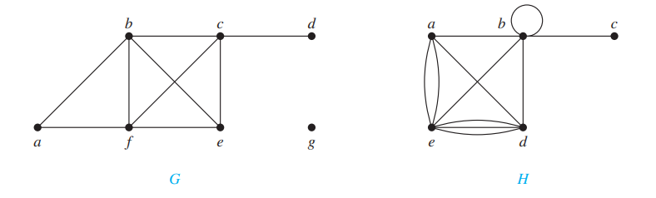
Some Basic Terminologies
An Example to understand the degree of a vertex in an undirected graph and the neighborhood:

Slide 7
Some Basic Terminologies
In G,
Degrees : deg(a) = 2, deg(b) = deg(c) = deg(f ) = 4, deg(d) = 1, deg(e) = 3, and deg(g) = 0.
The neighborhoods of these vertices are N(a) = {b, f }, N(b) = {a, c, e, f }, N(c) = {b, d, e, f }, N(d) = {c}, N(e) = {b, c, f }, N( f) = {a, b, c, e}, and N(g) = ∅.
In H,
Degrees : deg(a) = 4, deg(b) = deg(e) = 6, deg(c) = 1, and deg(d) = 5.
The neighborhoods of these vertices are N(a) = {b, d, e}, N(b) = {a, b, c, d, e}, N(c) = {b}, N(d) = {a, b, e}, and N(e) = {a, b, d}.

Slide 8
Handshaking THEOREM

Slide 9
Handshaking Theorem
Let G = (V, E) be an undirected graph with m edges.
Then 2m = ∑ _{v∈V} deg(v). (Note that this applies even if multiple edges and loops are present.)
It states that the sum of the degrees of all vertices in an undirected graph is equal to twice the number of edges.

Slide 10
Handshaking Theorem
Example 3: How many edges are there in a graph with 10 vertices each of degree six?
Solution: Because the sum of the degrees of the vertices is 6 ⋅ 10 = 60, it follows that 2m = 60 where m is the number of edges. Therefore, m = 30

Slide 11
Handshaking Theorem
Another Theorem (derived from handshaking theorem) : An undirected graph has an even number of vertices of odd degree
Let us at first draw some graphs to understand this
Then let us prove it mathematically

Slide 12
Some MORE basic terminologies

Slide 13
Some More Basic Terminologies
Defn4 When (u, v) is an edge of the graph G with directed edges, u is said to be adjacent to v and v is said to be adjacent from u. The vertex u is called the initial vertex of (u, v), and v is called the terminal or end vertex of (u, v). The initial vertex and terminal vertex of a loop are the same.

Slide 14
Some More Basic Terminologies
Defn 5 : In a graph with directed edges the in-degree of a vertex v, denoted by deg−(v), is the number of edges with v as their terminal vertex. The out-degree of v, denoted by deg+(v), is the number of edges with v as their initial vertex. (Note that a loop at a vertex contributes 1 to both the in-degree and the out-degree of this vertex.)

Slide 15
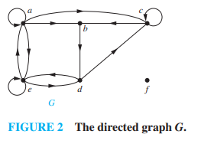
Some More Basic Terminologies
Find the in-degree and out-degree of each vertex in the graph G with directed edges shown in Figure 2.

Slide 16
Some More Basic Terminologies
Find the in-degree and out-degree of each vertex in the graph G with directed edges shown in Figure 2.
Solution:
The in-degrees in G are
deg−(a) = 2, deg−(b) = 2, deg−(c) = 3, deg−(d) = 2, deg−(e) = 3, and deg−(f) = 0.
The out-degrees in G are
deg+(a) = 4, deg+(b) = 1, deg+(c) = 2, deg+(d) = 2, deg+(e) = 3, and deg+( f) = 0.

Slide 17
Some More Basic Terminologies
The sum of the in-degrees and the sum of the out-degrees of all vertices in a graph with directed edges are the same.
Both of these sums are the number of edges in the graph.
Let G = (V, E) be a graph with directed edges.
Then ∑ _{v∈V} deg−(v) = ∑ _{v∈V} deg+(v) = |E|

Slide 18
Some More Basic Terminologies
Then ∑ _{v∈V} deg−(v) = ∑ _{v∈V} deg+(v) = |E|
9
12
8
Solution:
The in-degrees in G are
deg−(a) = 2, deg−(b) = 2, deg−(c) = 3, deg−(d) = 2, deg−(e) = 3, and deg−(f) = 0.
The out-degrees in G are
deg+(a) = 4, deg+(b) = 1, deg+(c) = 2, deg+(d) = 2, deg+(e) = 3, and deg+( f) = 0.
1
10
11
12
1
2
7
6
4
12
3
5

Slide 19
SOME SPECIAL GRAPHS

Slide 20
Some Special Graphs
A complete graph on n vertices, denoted by K_{n}, is a simple graph that contains exactly one edge between each pair of distinct vertices.

Slide 21
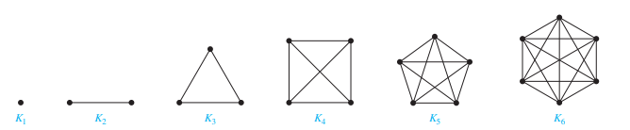
Some Special Graphs
A complete graph on n vertices, denoted by K_{n}, is a simple graph that contains exactly one edge between each pair of distinct vertices.

Slide 22
Some Special Graphs
A simple graph for which there is at least one pair of distinct vertex not connected by an edge is called non compete.

Slide 23
Some Special Graphs
Cycles A cycle C_{n}, n ≥ 3, consists of n vertices v₁, v₂, … , v_{n} and edges {v₁, v₂}, {v₂, v₃}, … , {v_{n−1}, v_{n}}, and {v_{n}, v₁}. The cycles C₃, C₄, C₅, and C₆ are displayed in Figure 4.
Observe that the edges have been denotes using set (undirected edges)

Slide 24
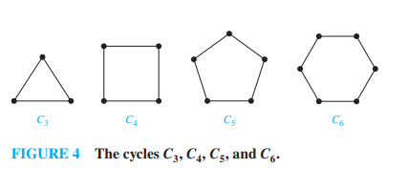
Some Special Graphs
Cycles A cycle C_{n}, n ≥ 3, consists of n vertices v₁, v₂, … , v_{n} and edges {v₁, v₂}, {v₂, v₃}, … , {v_{n−1}, v_{n}}, and {v_{n}, v₁}. The cycles C₃, C₄, C₅, and C₆ are displayed in Figure 4.
Observe that the edges have been denotes using set (undirected edges)

Slide 25
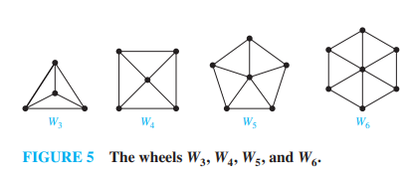
Some Special Graphs
A wheel graph is a special type of undirected graph that consists of a cycle graph with an additional central vertex, called the hub, which is connected to every other vertex in the cycle.

Slide 26
Some Special Graphs
n-Cubes An n-dimensional hypercube, or n-cube, denoted by Q_{n}, is a graph that has vertices representing the 2n bit strings of length n. Two vertices are adjacent if and only if the bit strings that they represent differ in exactly one bit position. We display Q1, Q2, and Q3 in Figure 6.

Slide 27
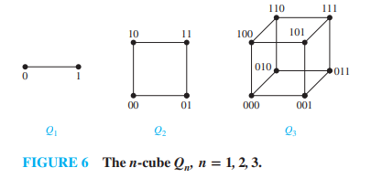
Some Special Graphs
n-Cubes An n-dimensional hypercube, or n-cube, denoted by Q_{n}, is a graph that has vertices representing the 2^{n} bit strings of length n. Two vertices are adjacent if and only if the bit strings that they represent differ in exactly one bit position. We display Q1, Q2, and Q3 in Figure 6.

Slide 28
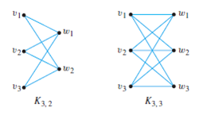
Some Special Graphs
Bipartite Graphs:

Slide 29
Bipartite Graphs

Slide 30
Bipartite Graphs
A simple graph G is called bipartite if
its vertex set V can be partitioned into two disjoint sets V1 and V2
such that every edge in the graph connects a vertex in V1 and a vertex in V2
(so that no edge in G connects either two vertices in V1 or two vertices in V2).
When this condition holds, we call the pair (V1, V2) a bipartition of the vertex set V of G.

Slide 31
Bipartite Graphs
B
5
Is this graph
Bipartite?
2
4
A
C
D
1
3

Slide 32
Bipartite Graphs
2
3
4
1
5
A
B
C
D

Slide 33
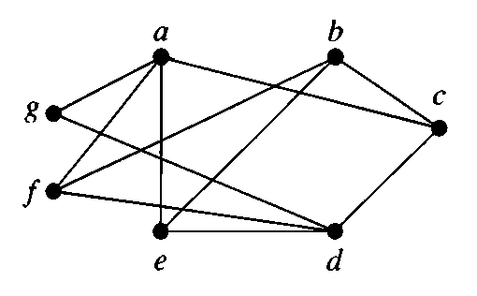
Bipartite Graphs
A graph is given to you, how will you know whether it is bipartite or not?

Slide 34
Bipartite Graphs
A
C
B
E
D
F
G

Slide 35
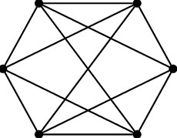
Bipartite Graphs
Vertices of same color have become adjacent.
Hence cannot be bi-partitioned
Hence it is not bipartite

Slide 36
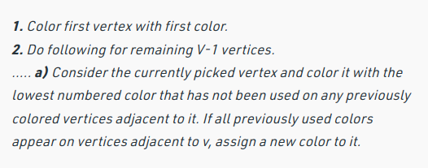
An easier approach you can use for graph coloring
Coloring with the lowest number
If you get more than 2 colors, then it is not bipartite

Slide 37
Thank You

